Slide 1
Husky ADAPT VIP
Weekly AOI: Week 5
Transfer Team
Hyeongju Choi, Ritika Gupta, Jasmine Hawkins, Sharon Heung, YoonBo Shim

Slide 2
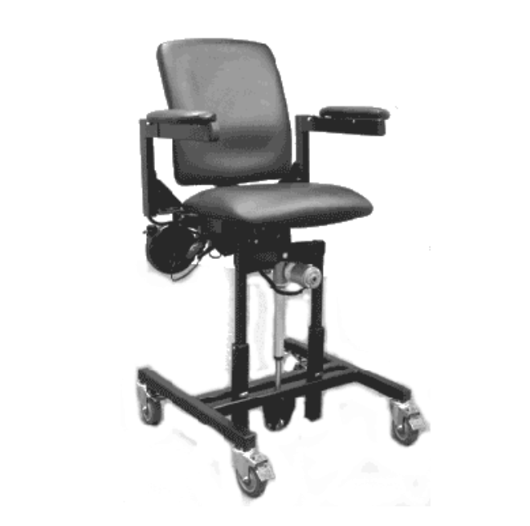
Accomplishments
Met with Carolee and her husband Tom (Thank you Dr. Steele for supporting us!)
Learned about the progression of Carolee’s condition
Deeper focus on the strength in her core, not the weakness in her arms and thighs
Received contact information of employee previously working with Carolee
Carolee’s Freedom Chair

Slide 3

Objectives Issues
Piece through recording and summarize Carolee’s key priorities
Learn about Carolee’s Freedom Chair
Research any existing assistive technologies that do not rely on muscle strength
Brainstorm ideas!!!
Get in touch with Carolee’s contact
Bonding activity!
Did not take a picture with Carolee :(
Did not record video of Carolee transferring (hope to receive one!)

